Slide 1
Information Technology
The Digital Backbone

Slide 2
Agenda For Information Technology
What is Information Technology (IT)?
Why IT is Crucial for Modern Business
Core Components: Hardware vs. Software
Key IT Functions in an Organization
The Symbiosis of IT and Business Strategy

Slide 3
What is Information Technology (IT)?
Definition: The use of computers, software, networks, and other digital devices to store, process, protect, and transmit data for an organization.
Simple View: Anything an organization uses an endpoint device (computer, phone, server) for can be classified as IT.
Core Purpose: To build organizational infrastructure and enable digital communication.

Slide 4
Why is IT Important for business?
Improves Efficiency & Productivity: Automates routine tasks, streamlines workflows, reduces manual errors.
Enhances Communication: Enables seamless collaboration via email, instant messaging, and video conferencing regardless of location.
Drives Innovation: Provides tools to explore emerging tech like AI and blockchain, creating new products and services.
Enables Data-Driven Decisions: Facilitates powerful data collection, storage, and analysis.

Slide 5
The Role of IT in Strategic Planning
IT is no longer just a support function; it's a strategic partner.
Digital Transformation: The process of integrating technology into all areas of a business, fundamentally changing how it operates and delivers value.
Without strong IT, digital transformation is haphazard and disorganized.
IT professionals set up protocols to manage and monitor these complex environments successfully.

Slide 6
Core IT Components: Hardware
Definition: The physical, tangible components of a computer system.
Examples:
Central Processing Unit (CPU) : The "brain" that processes instructions.
Hard Drive: Provides long-term data storage for the OS and applications.
Random Access Memory (RAM) : Temporary, high-speed storage for active tasks.
Motherboard: The main circuit board connecting all components.

Slide 7
Core IT Components: Software
Definition: The programs and instructions that tell the hardware what to do.
Examples:
System Software: The operating system (e.g., Windows, macOS) that manages hardware.
Application Software: Programs for end-users (e.g., web browsers, MS Office).
Utility Software: Background tools for security (anti-virus), optimization, and disk cleanup.

Slide 8
Core IT Function #1: IT Governance
Aligning IT goals and strategy with overall business objectives.
Key Activities:
Careful budgeting and resource allocation for IT projects.
Managing and mitigating technology-related risks.
Ensuring compliance with internal and external standards.
Ensuring IT decisions add value to the business.

Slide 9
Core IT Function #2: IT Operations (ITOM)
Focuses on the daily, routine management of IT infrastructure.
Often automated using IT Operations Management (ITOM) solutions.
Key Activities:
Monitoring endpoints and the network for problems.
Tracking and resolving incidents and events.
Deploying patches and software updates.
Providing remote support to users.

Slide 10
Core IT Function #3: Cybersecurity & Data Management
Purpose: Protecting the organization’s data and network from threats (malware, phishing, ransomware).
Key Aspects:
Data Security: Using firewalls, encryption, access controls, and strong credentials.
Database Management (DBMS): Provides visibility and control over stored data.
Principle of Least Privilege: Giving users only the access they absolutely need to do their jobs.

Slide 11
Core IT Function #4: Data Backup & Recovery
Critical for disaster recovery and protection against ransomware or hardware failure.
Key Concepts:
Regular, scheduled backups are essential.
The 3-2-1 rule: Keep at least 3 copies of data, on 2 different media types, with 1 copy off-site.
Backup types: Cloud-based, local, or a hybrid model.
Backups must be tested to ensure the data is usable.

Slide 12
The Link Between Business & IT Strategy
Misalignment: A common cause of business failure. IT projects do not support business goals.
Alignment: When business and IT strategies are coordinated, the organization can adapt quickly, seize opportunities, and gain a competitive advantage.
Goal: To create a dynamic capability where IT is a driver, not a barrier, to business success.

Slide 13
Data Types, Sources, and Lifecycle
Understanding Data
Types, Sources, and the Complete Data Lifecycle

Slide 14
Data Types, Sources, and Lifecycle Agenda
The Three Types of Data: Structured, Semi-structured, Unstructured
Internal vs. External Data Sources
What is Data Collection?
The 8 Stages of the Data Lifecycle Management (DLM)
Data Integrity vs. Data Quality

Slide 15
Data Type #1: Structured Data
Definition: Data that is highly organized and follows a predefined schema or model.
Format: Rows and columns in a relational database (tables).
Examples: Excel spreadsheets, SQL databases (e.g., sales records, customer names in a CRM).
Pros: Easy to search, analyze, and process by machines.
Cons: Not flexible; requires a fixed format.

Slide 16
Data Type #2: Unstructured Data
Definition: Data that has no predefined organizational model or format. It's often text-heavy or contains non-textual elements.
Examples: Images, audio files, video files, social media posts, PDF documents, email bodies.
Pros: Highly flexible; rich in context and meaning.
Cons: Difficult to process, search, and analyze directly.

Slide 17
Data Type #3: Semi-structured Data
Definition: Data that doesn't reside in a rigid table but still contains tags or markers to separate data elements and enforce hierarchies.
Examples: JSON, XML, HTML code, CSV files.
Pros: More flexible than structured data, but easier to process than unstructured data. It's "self-describing."
Analogy: A detailed email with a subject line, sender, and body text, but no fixed table structure.

Slide 18
Sources of Data: Internal vs. External
Internal Data Sources: Data generated from within the organization. It is proprietary and often unique.
Examples: Sales records, customer support logs, internal financial data, employee timesheets.
External Data Sources: Data gathered from outside the organization.
Examples: Public government datasets (census), social media feeds, market research reports, data from partners or third-party APIs.

Slide 19
What is Data Collection?
Definition: The systematic process of gathering and measuring information from various sources to get a complete and accurate picture of an area of interest.
Data collection enables: Analysis, decision-making, and answering of critical business questions.
Key Requirement: The method used must be valid (measuring what it intends to) and reliable (producing consistent results).

Slide 20
Primary vs. Secondary Data Collection
Primary Data: Data collected firsthand by the user specifically for their own purpose.
Methods: Surveys, interviews, focus groups, direct observation, experiments.
Pros: Highly specific, relevant, and controlled.
Cons: Expensive and time-consuming.
Secondary Data: Data that already exists and was collected by someone else for another purpose.
Sources: Government reports, industry journals, company databases, academic papers.
Pros: Cheap and fast to obtain.
Cons: May not be perfectly relevant or fit the current question.

Slide 21
Introduction to Data Lifecycle Management (DLM)
Definition: A policy-based approach to managing the flow of an organization's data throughout its lifecycle—from creation and initial storage to the time it becomes obsolete and is deleted.
Goal: To ensure data is available, secure, and properly managed at all stages for optimal business value and compliance.

Slide 22
Stage 1-2: Create & Store
Create/Collect: The data is generated or acquired. This could be from a user input, sensor, system log, or external purchase.
Store: The data is saved in a repository. This could be a database, data lake, filing system, or cloud storage. The storage method depends on the data's type and value.

Slide 23
Stage 3-4: Use & Share
Use: The data is accessed and utilized for a specific purpose (e.g., viewing a report, running a query, training an AI model). Data integrity is critical here.
Share: The data is made available to other users, departments, or partner organizations. This stage demands strong security controls (access control, encryption) to prevent leaks.

Slide 24
Archive & Destroy
Archive: Data that is no longer actively used but must be retained for legal, regulatory, or historical reasons is moved to long-term, low-cost storage.
Destroy: Data that is no longer needed and has passed its retention period is securely and permanently deleted. This stage is critical for reducing risk and complying with privacy laws like GDPR.

Slide 25
Data Integrity vs. Data Quality
Both are essential for trust in data, but they are different.
Data Integrity: Focuses on the wholeness, accuracy, and consistency of data over its entire lifecycle. Is the data unaltered and trustworthy?
Maintained by: Access controls, audit trails, backup/recovery, data validation rules.
Data Quality: Focuses on fitness for use. Is the data correct, complete, and timely for a specific purpose?
Measured by: Accuracy, completeness, consistency, timeliness, validity.

Slide 26
Data Lifecycle Management Summary
Analogy: Pet Data Management
Collect: You buy a puppy.
Store: You build a fenced yard.
Use: You play with the puppy daily.
Share: You let your neighbor pet the puppy.
Archive: The puppy grows old and rests more.
Destroy: End-of-life care.

Slide 27
Key Takeaway for Data Management
Poor Data Integrity = Unreliable Data (You can't trust it).
Poor Data Quality = Useless Data (Even if you trust it, it's wrong for the task).
Goal: Implement processes to ensure both high data integrity and high data quality throughout every stage of the data lifecycle.

Slide 28
Summary of DLM
We learned the three types of data: Structured, Semi-structured, and Unstructured.
We explored internal vs. external data sources and primary vs. secondary collection.
The 6-stage Data Lifecycle helps manage data from creation to destruction.
Data Integrity (wholeness) is different, but related to, Data Quality (fitness). Both are vital.

Slide 29
What is Enterprise Resource Planning (ERP)
What is ERP?

Slide 30
What is ERP?
ERP (Enterprise Resource Planning) is a software system that integrates and manages core business processes like finance, HR, supply chain, and manufacturing into a single, unified platform.
Key Benefits:
Centralizes data from all departments
Streamlines operations across the organization
Provides a real-time, single source of truth
Example: When a sales order is entered, inventory, accounting, and shipping are all updated automatically.

Slide 31
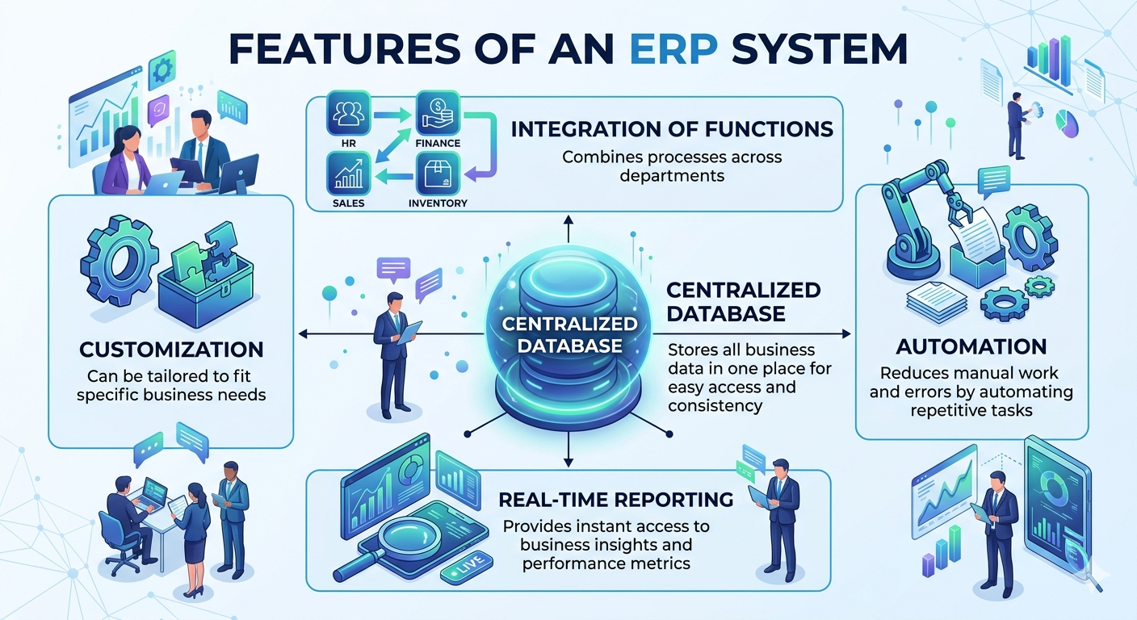
Key Features of ERP Systems

Slide 32
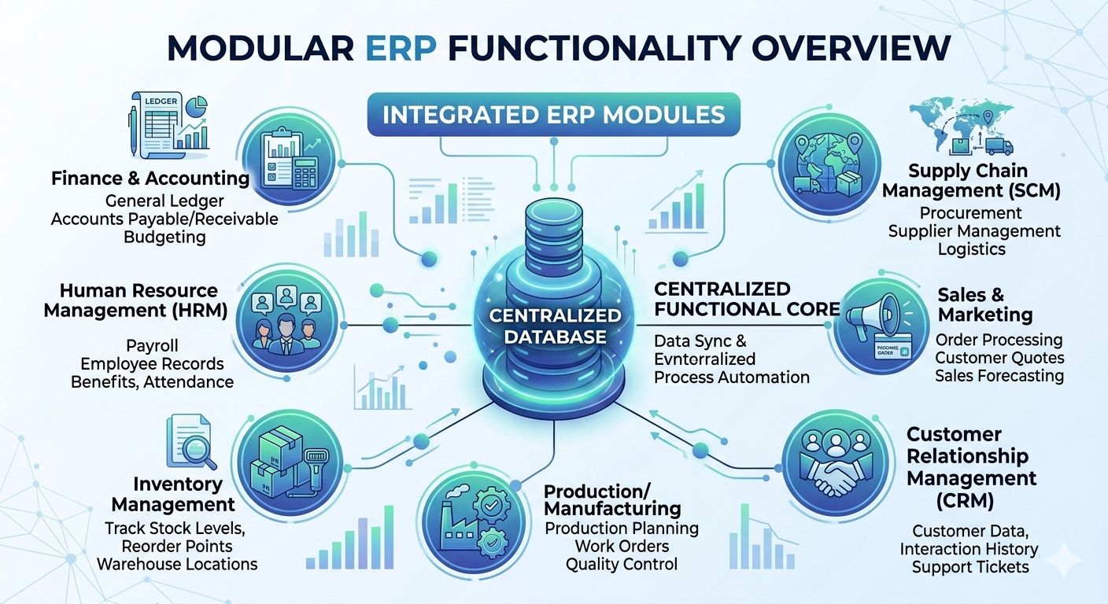
Core Modules in ERP

Slide 33
How ERP Works – Centralized Database
All departments (Finance, HR, Sales, Inventory) store and access data from ONE database
Data is entered once, used everywhere
Avoids data duplication and inconsistencies
Example:
When the sales team records a new order, the inventory and accounting modules are automatically updated – no manual entry needed.
Result: Everyone works with the same, real-time data.

Slide 34
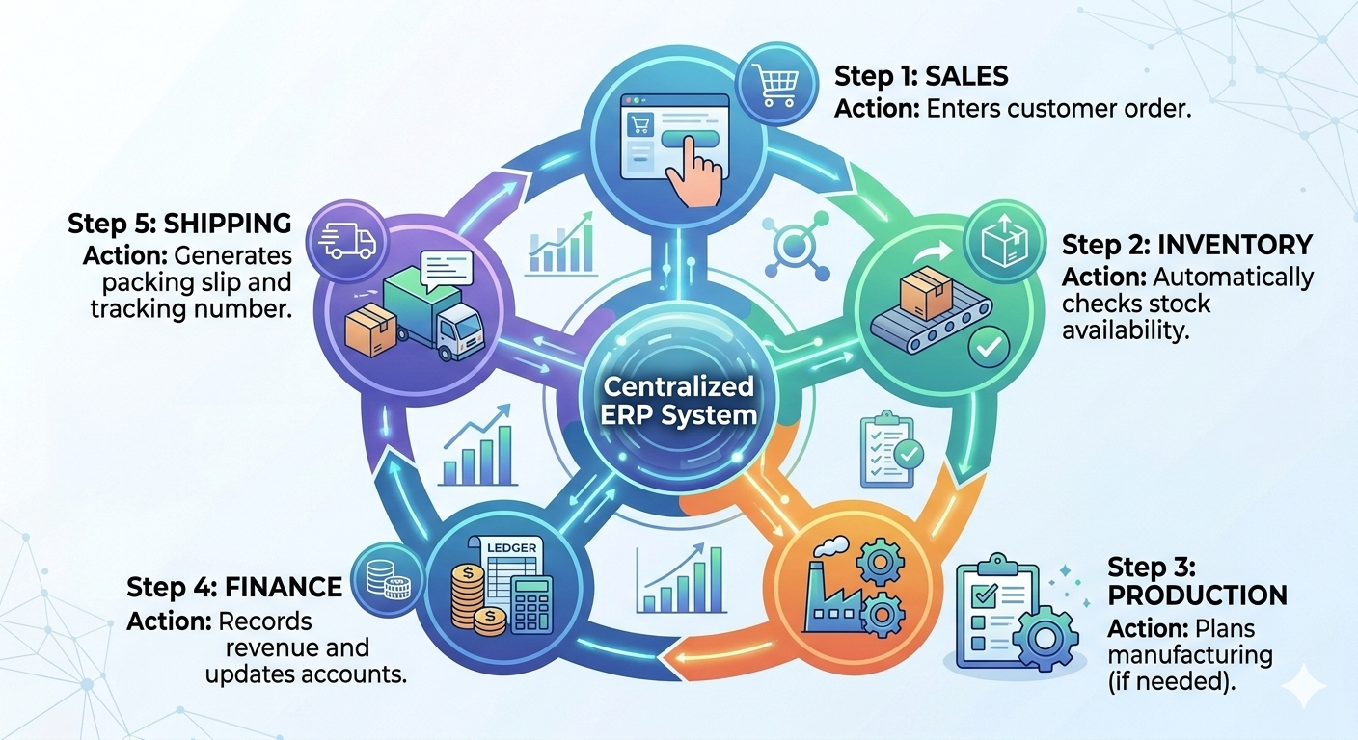
How ERP Works – Integration and Automation

Slide 35
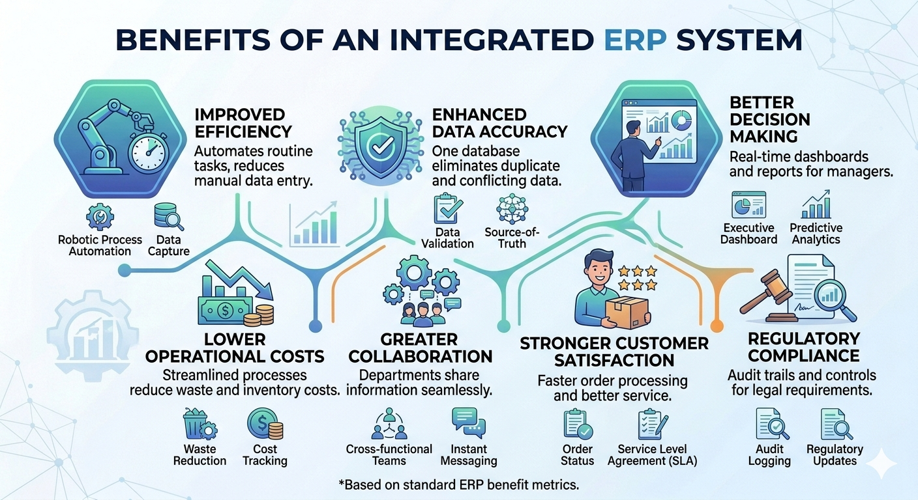
Top Benefits of ERP

Slide 36
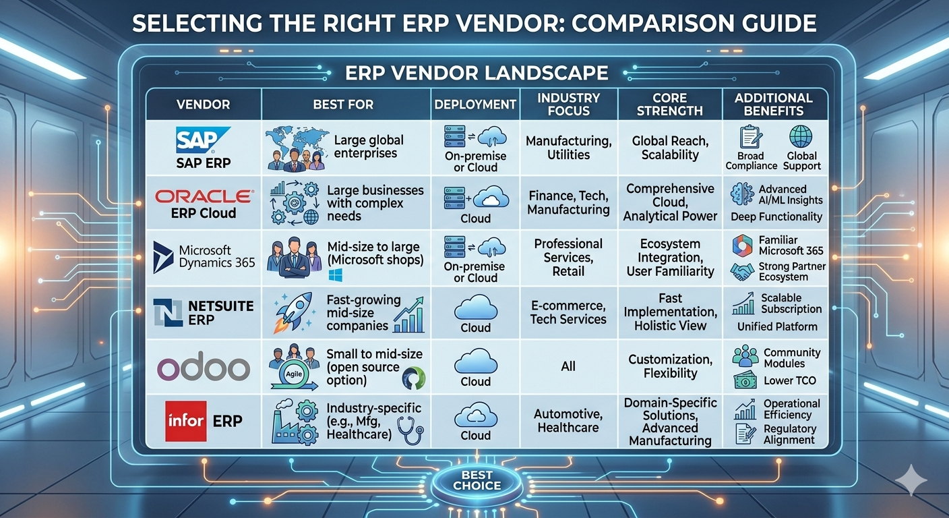
Popular ERP Software

Slide 37
ERP Security and Access Control
How ERP protects sensitive information:
Role-Based Access Control (RBAC): Users only access data relevant to their job
Example: Sales staff see customer orders, NOT payroll data
Data Encryption: Data is encrypted during transmission and storage
User Authentication: Strong passwords, multi-factor authentication (MFA)
Audit Trails: Every data access and change is logged
Regular Backups: Data is backed up to prevent loss from ransomware or disaster

Slide 38
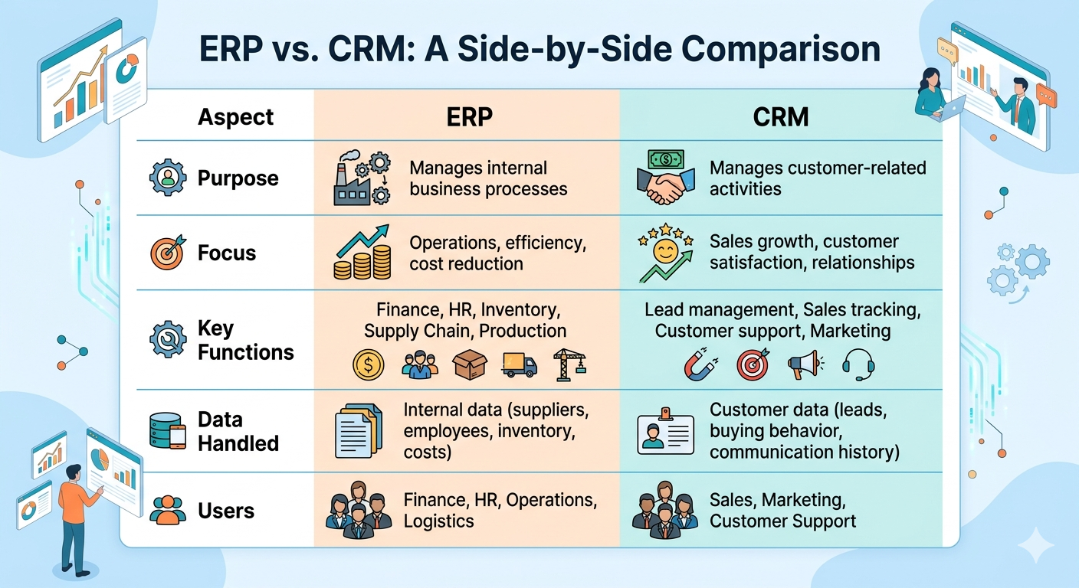
Topic: ERP vs CRM – Key Differences

Slide 39
Transition – From ERP to Data-Driven Decisions
Now that we understand how ERP integrates business data...
ERP collects and stores data from Finance, HR, Sales, Inventory, and Supply Chain
But data alone is not enough
Next Section:
How to analyze that data
How to make better decisions using Data-Driven Decision Making (DDDM)
Data → Information → Insights → Decisions

Slide 40
Topic: IT vs Computer Science
IT vs. Computer Science: What's the Difference?

Slide 41
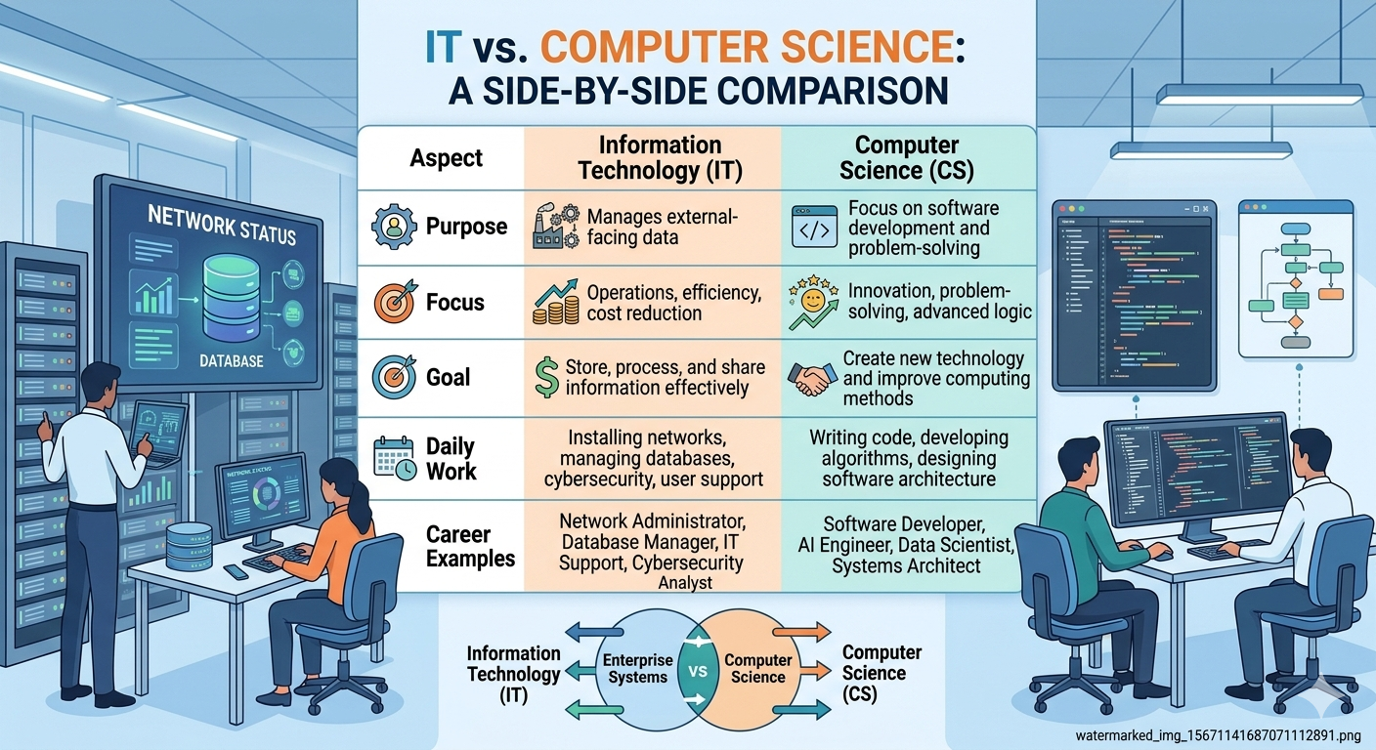
IT vs. Computer Science: What's the Difference?

Slide 42
Networking Types and Devices
PAN: Personal Area NetworkWithin a few meters Bluetooth connection between phone and laptop
LAN:Local Area Network Within a building or office,Office computers connected to a printer
MAN:Metropolitan Area Network Within a city Cable TV network connecting a city
WANWide Area NetworkAcross cities or countriesThe Internet
Network Devices:
Router: Connects different networks and directs traffic
Switch: Connects devices within the same network
Hub: Broadcasts data to all devices (older technology)
Modem: Connects home/office to Internet Service Provider
Access Point: Creates wireless network (Wi-Fi)

Slide 43
Cloud Computing (IaaS, PaaS, SaaS)
Provides computing services (servers, storage, databases, software) over the Internet on a pay-as-you-go basis.
Three Service Models:
IaaS (Infrastructure as a Service):Virtual servers, storage, networking eg.AWS EC2, Google Compute Engine
PaaS (Platform as a Service):Platform to build and deploy apps,Google App Engine, Heroku
SaaS (Software as a Service):Software applications over internet eg.Gmail, Microsoft 365, Salesforce

Slide 44
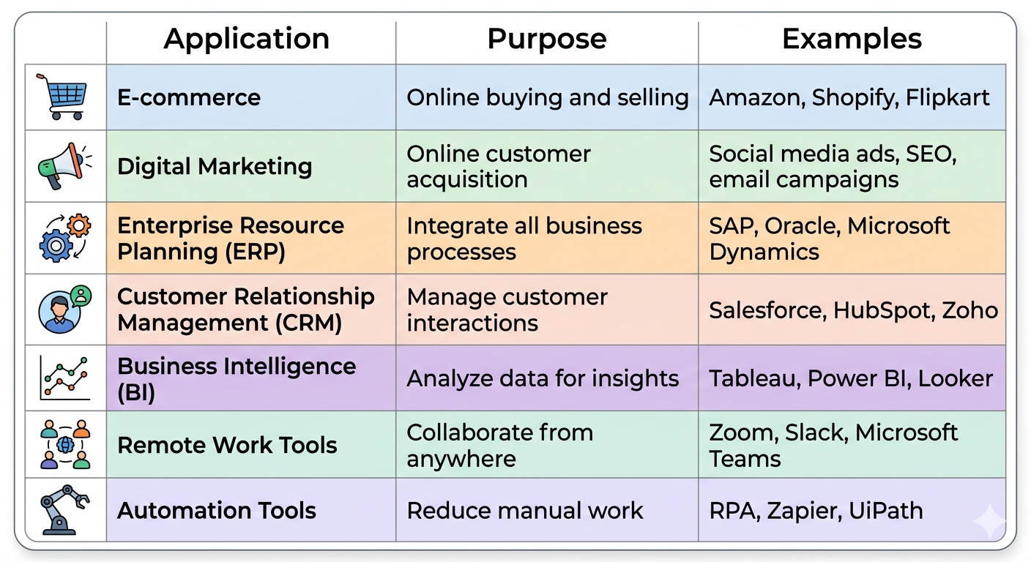
Applications of IT in Business

Slide 45
IT in Education and Society
In Education:
E-learning platforms (Coursera, Udemy, Khan Academy)
Virtual classrooms and video lectures
Digital libraries and research tools
Online examinations and grading systems
In Society:
Social media connecting people globally
Digital communication (email, messaging, video calls)
E-government services (online tax filing, digital IDs)
Healthcare IT (telemedicine, electronic health records)
IT creates social awareness and enables global connectivity

Slide 46
Database Management Systems (DBMS) and SQL
Definition: A Database Management System (DBMS) is software that allows users to create, manage, and interact with databases.
Popular DBMS Examples:
MySQL (open source, very popular for web apps)
Oracle Database (enterprise-grade)
Microsoft SQL Server (integrates with Microsoft products)
PostgreSQL (advanced open source)
MongoDB (NoSQL database)
SQL (Structured Query Language): The standard language for managing databases.

Slide 47
Waterfall Methodology
Approach: A linear, sequential process where each phase must be completed before the next begins.
Phases:
Requirements Gathering
Design
Implementation (Development)
Verification (Testing)
Maintenance
Best for: Projects with stable, well-defined requirements from the start.
BA Role in Waterfall:
Gather complete requirements at the beginning
Prepare detailed documentation (BRD, SRS, Use Cases)
Get sign-off from stakeholders before development starts
Limited scope for changes later

Slide 48
Agile Methodology: Iterative and Flexible
Approach: An iterative, incremental approach focusing on flexibility, collaboration, and responding to change.
Key Principles:
Embraces feedback and changing requirements
Breaks work into small pieces (user stories)
Uses short, time-boxed cycles called sprints (1-4 weeks)
Delivers working software continuously
Popular Frameworks: Scrum, Kanban, Lean, XP (Extreme Programming)
Best for: Projects where requirements may evolve or change, and continuous feedback is valuable.
BA Role in Agile:
Works continuously with stakeholders
Refines requirements each sprint
Participates in daily stand-ups, sprint planning, and reviews

Slide 49
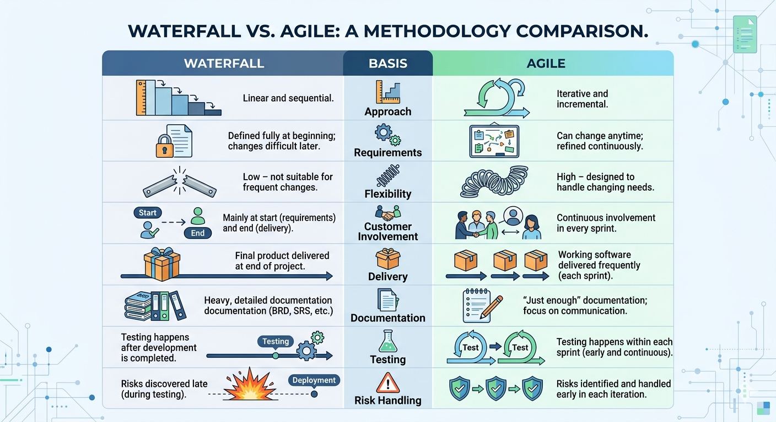
Waterfall vs Agile – Key Differences

Slide 50
When to Use Waterfall
Use Waterfall when:
Requirements are clear and stable – the project has a well-defined scope from the start
The project is straightforward and uncomplicated – a linear approach works well
Strict documentation and regulatory compliance are required – Waterfall's structured phases support thorough documentation
Customer involvement is limited – client input is primarily at the beginning and end
A fixed schedule and budget are the main drivers – Waterfall's structure allows for a clear upfront plan
Example Industries: Construction, manufacturing, government contracts, banking systems

Slide 51
When to Use Agile
Use Agile when:
Requirements are likely to change – Agile's flexible, iterative approach is ideal for evolving needs
Fast delivery is a priority – allows for incremental releases of functional parts
Customer feedback is crucial – continuous collaboration and feedback loops are built in
The project is complex or uncertain – accommodates innovation and emerging technologies
Cross-functional teams work collaboratively – developers, designers, and testers work together in cycles
Example Industries: Software development, mobile apps, startups, digital marketing, AI/ML projects

Slide 52
What is Stakeholder Management?
Definition: Stakeholder management is the process of identifying, analyzing, and engaging with individuals, groups, or organizations that can affect or are affected by a project or business.
Goal: Manage stakeholders' interests and expectations to ensure the initiative's success by building positive relationships and trust.

Slide 53
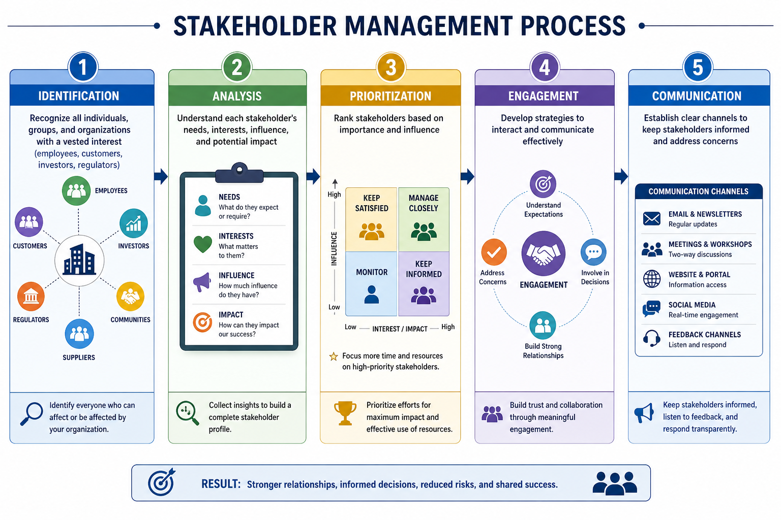
What is Stakeholder Management?

Slide 54
Benefits of Stakeholder Management
Relationship & Trust Benefits:
Builds trust and confidence: Transparent communication demonstrates commitment to stakeholders' needs
Strengthens relationships: Proactive engagement builds strong partnerships
Manages expectations: Structured approach ensures realistic expectations, increasing satisfaction
Strategic & Competitive Benefits:
Provides competitive advantage: Understanding stakeholder interests uncovers innovation opportunities
Enhances reputation: Proactive stakeholder management improves company reputation
Offers business intelligence: Insights from stakeholders lead to new product or service ideas
Project Success Benefits:
Comprehensive requirements: Working with diverse stakeholders uncovers all necessary information
Increased buy-in: Involving stakeholders makes them feel heard, increasing support for final solution
Risk mitigation: Open communication helps identify potential issues early
Faster decision making: Trusting relationships allow for efficient conflict resolution

Slide 55
BUSINESS STRATEGY & IT ALIGNMENT
Business Strategy is created – Organization defines goals, direction, and competitive approach
IT Strategy is designed – Technology plan is built to support business strategy
Alignment Capability ensures connection – Regular reviews and communication keep both strategies coordinated
IT improves business performance – Technology enables efficiency, innovation, and growth5Shapes future business strategy – Successful IT implementation opens new strategic possibilities

Slide 56
Introduction to the Business Analyst (BA) Role
The Business Analyst (BA)
The Critical Bridge Between Business Needs and IT Solutions

Slide 57
Agenda for Introduction to the Business Analyst (BA) Role
What Does a Business Analyst Do?
The BA as a "Change Agent"
Core Competencies of a Successful BA
Key Deliverables and Artifacts
From Information to Knowledge to Action

Slide 58
Defining the Business Analyst Role
Definition: A business analyst is a professional who acts as a liaison between stakeholders (business leaders, users) and the technical team (developers, IT) to understand the business's problems, needs, and goals.
Primary Focus: To recommend solutions that deliver value to the organization. The solution could be a new process, a software feature, or an organizational change.

Slide 59
The BA as a "Bridge
Without a BA: Business needs are often communicated poorly to IT, leading to a final product that does not solve the real problem, wasted time, and budget overruns.
With a BA: The BA translates business problems into clear, actionable technical requirements. They also translate technical constraints back to business stakeholders. This ensures everyone is aligned.

Slide 60
Key Responsibility #1: Elicitation
Eliciting Requirements: The process of researching and discovering the true needs of stakeholders, not just their stated requests.
Techniques:
Conducting one-on-one interviews and running workshops.
Sending surveys and questionnaires.
Observing users in their daily work.
Analyzing existing process flows and data.

Slide 61
Key Responsibility #2: Analysis & Documentation
Analysis: Breaking down the elicited information to understand the core problem, identify inconsistencies, and find viable solution options.
Documentation: Creating clear, unambiguous artifacts that guide the technical team.
Common Artifacts:
Business Requirements Document (BRD): High-level goals.
Functional Requirements: What the system must do.
User Stories: "As a [user], I want [goal], so that [reason]".
Process Flow Diagrams: Visual maps of workflows.

Slide 62
Key Responsibility #3: Solution Assessment & Validation
The BA doesn't stop after handing off requirements.
Assessment: Evaluating proposed technical solutions to ensure they meet the business need effectively.
Validation (Testing): Working with QA testers to verify that the final developed product fulfills the original requirements.
User Acceptance Testing (UAT): Coordinating with business users to test the solution in a real-world scenario before final release.

Slide 63
Core Competencies of a Great BA
Communication (Written & Verbal): The #1 skill. Translating jargon between business and IT.
Critical Thinking & Problem-Solving: Analyzing root causes, not just symptoms.
Stakeholder Management: Managing varied (and sometimes conflicting) interests and expectations.
Process Modeling: Using tools like BPMN or UML to map workflows visually.
Facilitation & Negotiation: Leading meetings and helping groups reach a consensus.

Slide 64
Why is Information Critical for a BA?
Information (processed data) is the BA's primary raw material.
A BA transforms raw data from logs, surveys, and systems into information (e.g., "Support ticket volume increased 40% last month").
That information is then combined with context and expertise (e.g., "This spike is due to the new update we released") to form knowledge ("The update has a critical bug").
This knowledge drives action and wisdom ("We need to roll back the update and fix the bug").

Slide 65
The BA and Decision-Making
BAs provide the structured information and analysis that powers organizational decision-making.
Without a BA: Decisions are based on gut feelings, politics, or incomplete data. High risk.
With a BA: Decisions are based on evidence, clear options, and an understanding of trade-offs. Lower risk, better outcomes.

Slide 66
Summary of BA
The Business Analyst is the critical bridge between business problems and technical solutions.
Core responsibilities: Elicitation, Analysis/Documentation, and Solution Validation.
Key skills: Communication, critical thinking, and stakeholder management.
BAs transform raw data into actionable knowledge to inform strategic decisions

Slide 67
Overview of Data-Driven Decision Making (DDDM)
Data-Driven Decision Making (DDDM)
Replacing Intuition with Evidence

Slide 68
Agenda for DDDM
What is Data-Driven Decision Making?
The Critical Importance of DDDM in Modern Business
The Core Process of DDDM
Key Benefits & A Real-World Example (Scenarios)
Major Pitfalls to Avoid in DDDM

Slide 69
Defining Data-Driven Decision Making
Definition: The practice of basing organizational decisions on the analysis of hard data, verifiable facts, and evidence, rather than solely on intuition, observation, or gut feeling.
Core Principle: Let the data guide the decision. You form a hypothesis, gather data, analyze it, and then act based on the findings.

Slide 70
Why is DDDM Essential Now?
Volume & Velocity: Businesses generate more data in an hour than they did in a year, just a decade ago. This data contains immense value if analyzed.
Competitive Advantage: Competitors are already using data to understand customers, optimize prices, and predict trends. Lagging behind is a strategic risk.
Complexity: The modern business environment is too complex for a single leader to intuitively understand. Data provides clarity and pattern recognition.

Slide 71
The 5-Step DDDM Process
Step 1: Define the Objective: What question are you trying to answer? What decision needs to be made? (e.g., "Should we lower the price of Product X?").
Step 2: Collect Relevant Data: Identify and gather data that relates to your objective. Focus on data quality and relevance.
Step 3: Analyze the Data: Clean, process, and analyze the data to find patterns, correlations, and insights.
Step 4: Interpret and Decide: Interpret the analysis results. Does the data provide a clear answer? Make the decision based on the evidence.
Step 5: Act and Evaluate: Implement the decision and measure the outcomes. This evaluation becomes data for the next decision.

Slide 72
The Core Philosophy of DDDM
Move from "I think..." to "The data shows..."
Move from "We've always done it this way..." to "What does the evidence suggest now?"
Move from HiPPO decisions (Highest Paid Person's Opinion) to democratic, factual analysis.
Data is a tool to augment, not replace, human expertise and leadership. The leader still makes the final call but with better information.

Slide 73
The Immense Benefits of DDDM
Better Decision Quality: Reduced bias, lower risk of error.
Faster Decisions: Automated analysis and real-time dashboards can speed up response times significantly.
Improved Agility: Organizations can sense a market change and react quickly because they have the data to confirm the trend.
Enhanced ROI: Optimizing marketing spend, supply chains, and product features based on data increases profitability.

Slide 74
Real-World Example: Scenario Analysis
Definition: Scenario analysis is a DDDM technique that analyzes potential future events by considering alternative possible outcomes (scenarios).
Example: An energy company deciding whether to build a new wind farm.
Scenario A (Optimistic): Government tax credits are renewed, energy prices rise. (High ROI)
Scenario B (Base): Current market conditions continue. (Moderate ROI)
Scenario C (Pessimistic): New regulations increase costs, energy prices drop. (Negative ROI)
Decision: Build only if Scenario C's outcome is an acceptable risk.

Slide 75
Major Pitfall #1: Data Confirmation Bias
The Pitfall: Seeking out or interpreting data in a way that confirms your pre-existing beliefs or desired conclusion.
Example: You want to launch a new product, so you only look at small positive survey responses and ignore large negative customer feedback data.
Solution: Actively seek out data that could disprove your hypothesis. Assign a "red team" to challenge your findings.

Slide 76
Major Pitfall #2: Correlation vs. Causation
The Pitfall: Mistaking two things that happen together (correlation) for one thing directly causing the other (causation).
Example: Data shows a strong correlation between ice cream sales and drowning incidents.
False Conclusion: "Buying ice cream causes drowning."
Real Cause: "Hot weather" (the confounder) causes both an increase in ice cream sales and people swimming.
Solution: Think critically. Is there a logical connection? Are there hidden variables?

Slide 77
Summary of DDDM
DDDM means making decisions based on verifiable data, not just intuition.
It follows a process: Define → Collect → Analyze → Interpret & Decide → Act & Evaluate.
Benefits include higher quality, faster decisions, and improved ROI.
Major pitfalls include confirmation bias and confusing correlation with causation. Always be critical of your data.

Slide 78
Real-Life Case Discussions
Real-Life Case Discussions
Applying DDDM and Business Analysis in Practice

Slide 79
Agenda for Real-Life Case Discussions
Why Study Business Cases?
Case 1: Optimizing Operations (Netflix)
Case 2: Solving a Business Problem (Domino's Pizza)
Interactive Discussion Questions

Slide 80
The Value of Real-Life Cases
Theories and frameworks are essential, but cases show how they work in a messy, real-world environment.
Cases demonstrate consequences—both good and bad—of business decisions.
They help you build pattern recognition to apply to problems in your own future career.

Slide 81
Case 1: Netflix – A Master of Data-Driven Decisions
The Goal: Dominate the streaming entertainment market.
The Approach: Uses granular data for every major decision.
Content Creation: Analyzes viewing habits, search queries, and ratings to know exactly what genres, actors, and directors are popular. This spawned hits like "House of Cards."
Personalization: The recommendation engine (DDDM in action) drives 80% of content watched. It optimizes for user engagement.
Thumbnail Selection: A/B tests hundreds of thumbnail images per show to see which one gets the most clicks for an individual user.

Slide 82
Case 1: Analysis & Result for Netflix
Analysis: Netflix doesn't ask "What show should we make?" It asks "What data do we have that tells us what our customers will watch?" They have replaced creative hunches with algorithmic insights.
Result: A massive competitive moat, incredible customer retention, and billions of dollars in value. They have mastered the "Analyze" and "Act & Evaluate" steps of DDDM.

Slide 83
Case 2: Domino's Pizza – Solving with Data & IT
The Problem: By the late 2000s, Domino's had a reputation for terrible-tasting pizza. Sales and stock price were plummeting.
The BA Approach: They collected massive amounts of customer feedback (internal data source) and realized it wasn't just delivery times or service. The core problem was the product itself.
The Data-Driven Solution: They completely reinvented their pizza recipe from scratch. Then, they launched a "Pizza Turnaround" ad campaign, admitting their failures publicly and showing the new recipe.

Slide 84
Case 2: Analysis & Result for Domino's
Analysis: The BA role here was listening to the "voice of the customer" data. The solution was not a new IT system but a product reformulation. IT later played a huge role in the turnaround via the "Domino's Tracker" app, which provided transparency and built trust.
Result: A legendary turnaround. Stock price soared over 4,000% in the following years. They used data to admit fault, fix the core product, and then use IT to rebuild customer trust through transparency.

Slide 85
Real-Life Case Discussions : Discussion & Takeaways
Discuss:
What kind of data do you think Domino's analyzed beyond taste?
Could Netflix's strategy work for a small, local bookstore? Why/why not?
Core Takeaway: Real-world success comes from combining business analysis, IT systems, and a relentless focus on data to drive the right decisions and solutions.

Slide 86
Introduction to Data Governance
Introduction to Data Governance
The Rules of the Road for Your Data

Slide 87
Agenda for Introduction to Data Governance
What is Data Governance?
Why it's Critical: The Three Pillars (Compliance, Security, Value)
The People, Processes, and Technology of Governance
Core Policies You Need
Data Governance vs. Data Management

Slide 88
Defining Data Governance
Definition: A collection of practices, processes, policies, and roles that ensure the effective, secure, and compliant management of an organization's data assets.
Simple Analogy: Data governance is the "rules of the road" (stop signs, speed limits, traffic lights) that allows everyone to drive their cars (manage data) safely and efficiently without crashing.

Slide 89
Why is Data Governance Essential?
Pillar #1: Compliance: To adhere to laws like GDPR (EU) and CCPA (California). Non-compliance leads to massive fines (up to €20M or 4% of global turnover).
Pillar #2: Security: To protect sensitive data from breaches, leaks, and cyberattacks. A breach destroys customer trust.
Pillar #3: Value & Trust: To ensure data is reliable and trustworthy for decision-making ("Is this sales report accurate?"). Good governance drives business value.

Slide 90
The Three Core Components of Governance
People (The Actors): Who is responsible? Defines roles like Data Owner, Data Steward, Data Custodian, and the Data Governance Council.
Processes (The Rules): How is data handled? Standardized workflows for data access, quality checks, issue resolution, and compliance.
Technology (The Tools): What enforces the rules? Software for data cataloging, lineage tracking, metadata management, and access control.

Slide 91
Key Roles in Data Governance
Data Governance Council: Senior leaders who approve policies and fund the program.
Data Owner: A senior manager accountable for the quality and security of a specific data domain (e.g., "Customer Data" owner in Sales).
Data Steward: The hands-on person responsible for implementing the policies on a day-to-day basis, managing data quality, and solving issues.
Data Custodian: An IT role responsible for the technical environment (storage, backups, security) where data resides.

Slide 92
The Core Policies of Data Governance
Data Access Policy: Who can access what data, under what circumstances? (Includes role-based access control).
Data Quality Policy: Defines rules for data completeness, accuracy, and timeliness. Who checks it? How are errors fixed?
Data Retention & Disposal Policy: How long is data kept? When and how is it securely destroyed? Driven by legal and regulatory requirements.
Data Security & Privacy Policy: Rules for data classification (public, internal, confidential, restricted) and handling of Personal Identifiable Information (PII).

Slide 93
Data Governance vs. Data Management
This is a critical distinction:
Data Governance (Strategy): The WHAT and WHY. The framework of high-level policies, rules, and decision rights. It's about strategy, compliance, and accountability.
Data Management (Tactics): The HOW. The technical execution and daily activities (e.g., ETL processes, database tuning, building a data lake). It's about architecture, tools, and processes.
Relationship: Governance tells Management what to do, and Management does it.

Slide 94
CCPA vs. GDPR: A Governance Challenge
DPR (EU):
Opt-In Model: You must get explicit, active consent to process data.
Penalties: Up to €20 million or 4% of global annual turnover.
Scope: Applies to any company processing data of EU residents.
CCPA (California):
Opt-Out Model: Data can be collected, but users must be able to easily opt-out of its sale.
Penalties: Lower fixed fines (2,500perunintentionalviolation,2,500perunintentionalviolation,7,500 per intentional).
Governance Implication: A global company needs a unified governance program to handle the different rules for different user groups.

Slide 95
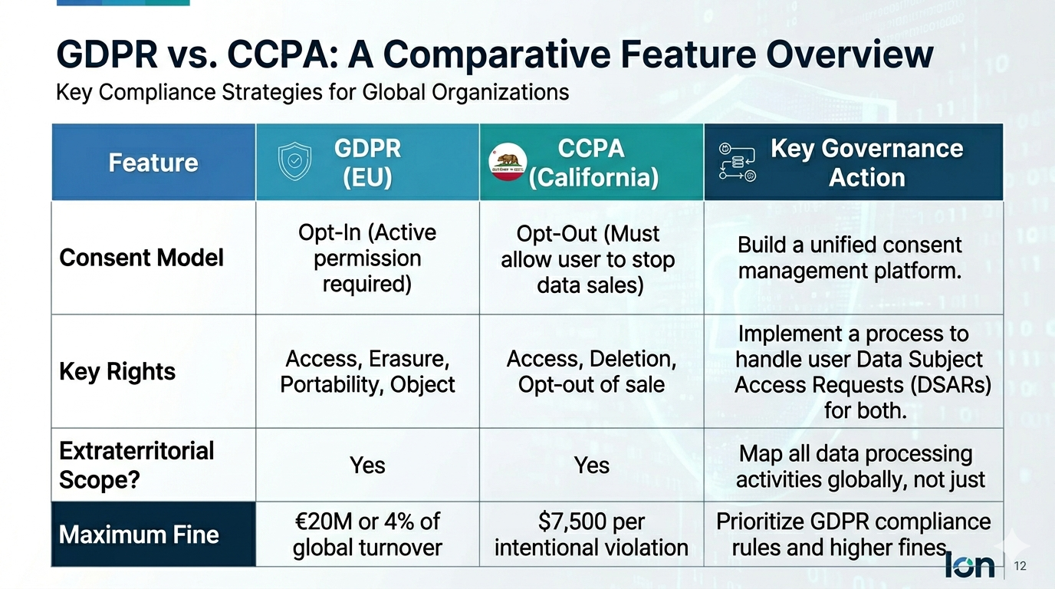
Governance Frameworks Comparison

Slide 96
Data Governance Summary
Data governance is the overall framework (people, processes, tech) for managing data effectively and securely.
Its three pillars are Compliance, Security, and building Trust/Value.
Key roles include Data Owners (accountable) and Data Stewards (hands-on).
Governance is the "what"; Management is the "how".
Laws like GDPR and CCPA are key drivers for strong governance.

Slide 97
Introduction to Data Ethics
Data Ethics
Doing the Right Thing With Data, Even When No One is Watching

Slide 98
Agenda for Data Ethics
What is Data Ethics?
The Four Core Principles of Ethical Data Practice
Why Does Data Ethics Matter? (Moral, Legal, Reputational)
Key Ethical Issues: Bias, Consent, and Transparency
From Compliance to a Culture of Ethics

Slide 99
Defining Data Ethics
Definition: The branch of ethics that studies and evaluates moral problems related to data, algorithms, and corresponding practices. It defines the right and wrong ways to collect, store, analyze, and share data.
Core Question: Not just "Can we do this with data?" but "Should we do this with data?"
It goes beyond legality: An action can be legal (e.g., selling anonymized user data) but still be ethically questionable.

Slide 100
Four Core Principles of Data Ethics
Privacy: Individuals have a right to control their personal information. Collection requires informed, freely given, and revocable consent.
Transparency: Be clear and open about what data is being collected, for what purpose, and who will have access to it. No "dark patterns" or hidden clauses.
Accountability: The organization and its people are responsible for their data practices and must be able to demonstrate compliance.
Fairness: Data practices should not create or reinforce bias, lead to discrimination, or produce unjust outcomes for individuals or groups.

Slide 101
The Many Reasons Why Data Ethics Matters
Moral Reasons:
Respect for human dignity and autonomy.
Preventing harm: Avoiding outcomes like financial discrimination or social profiling.
Promoting fairness and justice.
Legal Reasons:
Adhering to laws like GDPR is a baseline. Ethics helps you go beyond mere compliance.
Reduces risk of future regulations and lawsuits.
Reputational & Business Reasons:
Builds trust with customers, partners, and the public. Trust is a major competitive asset.
A strong ethical reputation differentiates you from less scrupulous competitors.

Slide 102
Key Ethical Issue #1: Bias
The Problem: Data and algorithms are not neutral. They reflect the biases of the humans who created them and the historical data they are trained on.
Examples:
A hiring algorithm trained on past successful employees (who were all men) penalizes female candidates.
A credit scoring model uses zip codes as a proxy, inadvertently discriminating against minority neighborhoods.
Ethical Practice: Actively audit data and models for bias. Use diverse teams to build and test systems.

Slide 103
Key Ethical Issue #2: Informed Consent
The Problem: Consent is often not real consent. "I agree" buttons are hidden behind long, unreadable legal text. Users feel coerced (e.g., must accept cookies to use a site).
Ethical Consent (from GDPR principles):
Freely Given: No coercion or penalty for refusal.
Specific: Separate consent for different purposes (e.g., analytics vs. marketing).
Informed: Plain, clear language about exactly what data will be used.
Revocable: Easy for the user to withdraw consent at any time.

Slide 104
From Compliance to a Culture of Ethics
Compliance Mindset: "What is the minimum we need to do to avoid a fine?" (Checklist-driven, reactive, fear-based).
Ethical Culture: "What is the right thing to do for our users and society?" (Value-driven, proactive, principle-based).
How to Build an Ethical Culture:
Get buy-in and modeling from leadership.
Provide regular ethics training for all employees who handle data.
Create safe channels for reporting ethical concerns.
Make "privacy by design" and "ethics by design" part of every new project's requirements.

Slide 105
Summary of Data Ethics
Data ethics is the moral framework for handling data. It asks "Should we?" not just "Can we?".
The core principles are Privacy, Transparency, Accountability, and Fairness.
Ethics is critical for preventing harm, building trust, and meeting your moral obligations.
A key goal is to move your organization from a "tick-box" compliance mindset to a true "culture of ethics."

Slide 106
Final Summary & Conclusion
IT & Business Strategy are fused. You cannot succeed in business today without an IT strategy that directly supports business goals.
Data is a critical asset. Understanding its types, lifecycle, and the difference between integrity and quality is fundamental.
The Business Analyst is the bridge. They translate business needs into technical actions and drive value.
Data-Driven Decision Making is a core competency. It replaces gut feeling with evidence, and you must avoid built-in biases like confirmation bias.
Governance & Ethics are not barriers, but enablers. A strong governance framework mitigates risk and builds trust. An ethical culture is a competitive advantage.

Slide 107
The Future Belongs to the Curious.
In a world full of data, be the leader who turns it into wisdom.

